Slide 1
Split Smart
By: Nidhi Patel, Elishbah, Zan, Pamela Shahu, Ahmed

Slide 2
Introduction
Users of Split Smart will be able to establish and keep track of spending as well as pay off any outstanding amounts for splitting costs with friends, roommates, family, coworkers, or other individuals or groups of people.
The scope, goals, and objectives of the new system are laid forth in this document.
This document represents the functional needs with use cases, interaction diagrams, and class models in addition to documenting the non-functional requirements.
The goal of this paper is to provide guidance for the object-oriented language used in the target system's design and implementation.

Slide 3
Project Summary
Project Name: Split Smart
Project Manager: Zhiwei Xu
Project Analysts: Nidhi, Elishbah, Pamela, Zan, Ahmed
Users: User and Group Manager

Slide 4
Background
SplitSmart is a web-based application with mobile apps for Android and IOS.
The software has user accounts, group management, expense creation, notification system, approval workflow, balance tracking, payment tracking, and reporting features.
Also allow users to create new expenses and add information such as amount, date, description.

Slide 5
Project Scope
The goal of this project is to provide a web-based tool that assists users in balancing their budgets and tracking their spending.
This project excludes product advertising, inventory management, and account billing.
The system will include an online search engine and a translator.
This project includes online security concerns that go beyond the site's password protection.

Slide 6
Users
Customers: Customers will find it simple to manage their finances once the system is in place.
Product Owners:
Product owners will be able to easily update the information about the website.
Customer Service:
Due to clients being able to get the information they want from the website, the new system results in a reduction in the workload of Customer Service.
Accounting:
Information about purchases will be delivered directly to Accounting, and get notification when a new payment is created.
Information technology:
This division is in charge of setting up the new database, hosting the website, and keeping everything running smoothly.

Slide 7
Responsibilities
User needs to log in
Guidance for website navigation
Users to create new expenses
Get notification when someone creates new expenses
Account has information such as amount, date, description, etc.
User track the balance owed by other user in the group
User can track payments that have been made to settle balances
Users will get reports of their expenses, balances, and payments.
Online help option in website navigation
Password protection scheme for non-public web pages

Slide 8
Overview
Section 2: Functional Objectives
Each goal outlines the system's expected behavior, and a test to see whether it has been effectively accomplished.
Section 3: Non-Functional Objectives
Each goal defines a technological need or restriction on the system's general features.
Section 4: Context Model
It describes the external entities that communicate with the system.
Section 5: Use Case Model
Use cases go into depth of the features. Use case is describing the purpose of a new system.
Section 6: Class Model
All analytical classes and their connections are displayed.

Slide 9
Functional Objectives
2.1 High Priority
The system will allow users to get registered in the system and log in to access to use the system function of creating expenses and managing that.
The system will allow users to create and manage groups of people. Users can share the expenses with group members.
The system will allow users to create new expenses.
Users will insert data about the expense in a form that consists of date, description, shared manner or split%, and image if any.
Users can also add members who are related to this expense to adjust the balance.
The system will send a notification to all the users when a group member creates a new expense.

Slide 10
2.2 Medium Priority
This system will provide a function to track the balance owed by each user to every other user, taking into account all expenses that have been entered.
The system will provide a function that will allow users to record when payments have been made to settle balances owed so that the balances are accurately reflected in the system.
The system will provide a function that will provide users with reports and summaries of their expenses, balances, and payments.

Slide 11
3. Non-Functional Objectives
Reliability
The system should be functional and available to the users 98% of the time, error prevention should be handled in this way.
Usability
There should be a user-friendly interface so users learn it quickly and they should be able to create an expense and user groups after 2 days of use.
Performance
The system should be able to handle 1000 users at a time and performance should not go down with the increasing number of users.
Security
The system should have a secure user authentication system that stores passwords and keys in encrypted form so unauthorized users may not access the system.

Slide 12
Supportability
The system should be capable of adding new features in the future to enhance the functionality of the system.
Online user Documentation and Help
There should be a user guide that has complete information to perform the task and explain all the steps to perform that task.
Purchased Components
None as we are utilizing free software available to us to program this project, the software we are utilizing is Android Studios.
Interfaces
Built in Database provided by Android Studios known as SQLite Database

Slide 13
Context Model - Goals
The goal of the system is to provide a way for users to track expenses and plan events with groups of varying size.
The SplitSmart system should provide an organized consolidation of all expenses for an event and a way to track payments.
The system should be secure and protect against unauthorized access of user accounts.

Slide 14
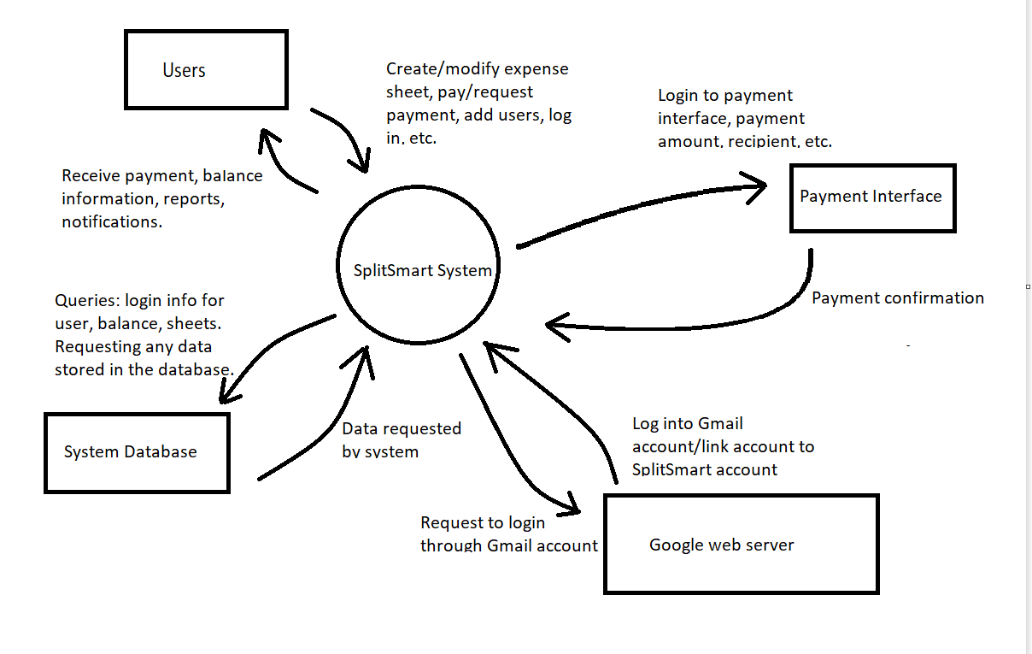
Context Model - Context Diagram

Slide 15
Context Model - Externals
Users: a user is any individual who uses the SplitSmart software. A user can create a SplitSmart expense sheet and share it with other users, pay and receive payment from other users, and add/remove expenses from the sheet. The users will receive a notification for different events within the system. The system will also provide a summary of the expenses.
Payment interface: A payment interface is a system such as PayPal, Zelle, etc. that allows users to pay, request, or receive payment from other users. Users should be able to connect a payment system to their account. The system will have to interface with this system to send queries.

Slide 16
Context Model - Externals cont.
Google web server: The SplitSmart software needs to interact with the Google web-server in order to allow users to create accounts through existing Gmail accounts.This interaction is needed so that users can link their Gmail accounts rather than creating an account with SplitSmart if they prefer.
System Database: The system database is a database that holds information about user accounts, SplitSmart expense sheets, etc. The system must interface with this database in order to retrieve information about users such as login information, associated expense sheets, and other information. The system will send queries to the database and receive back data.

Slide 17
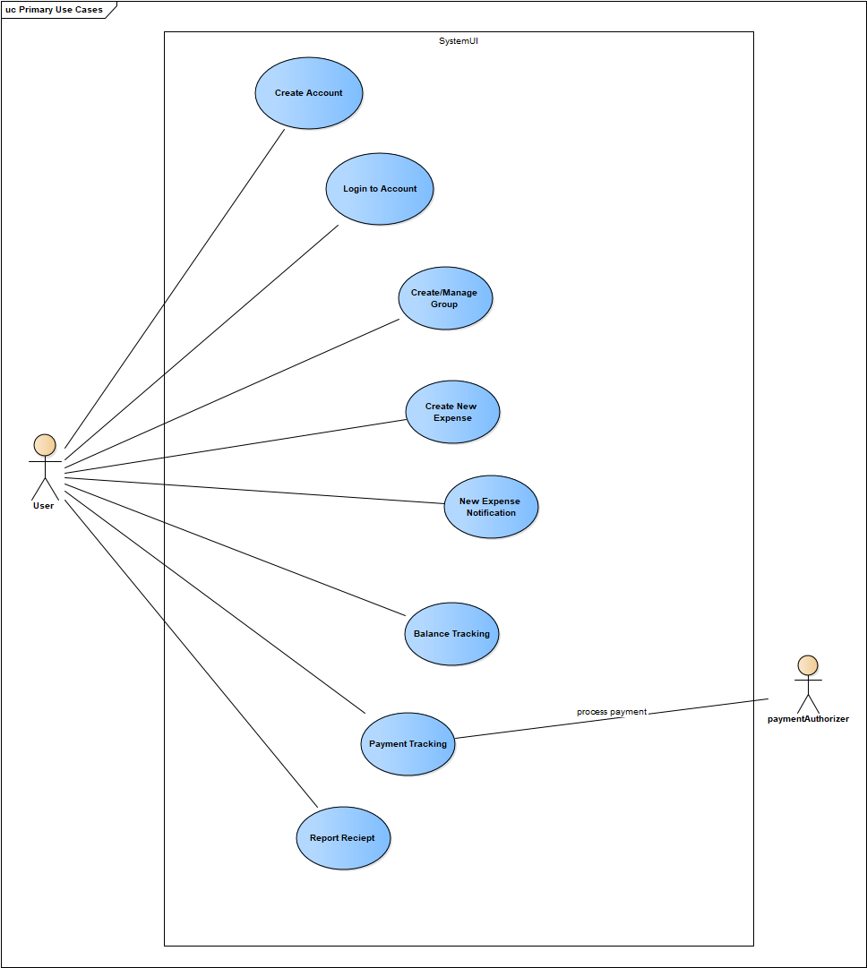
Use Case Diagram

Slide 18
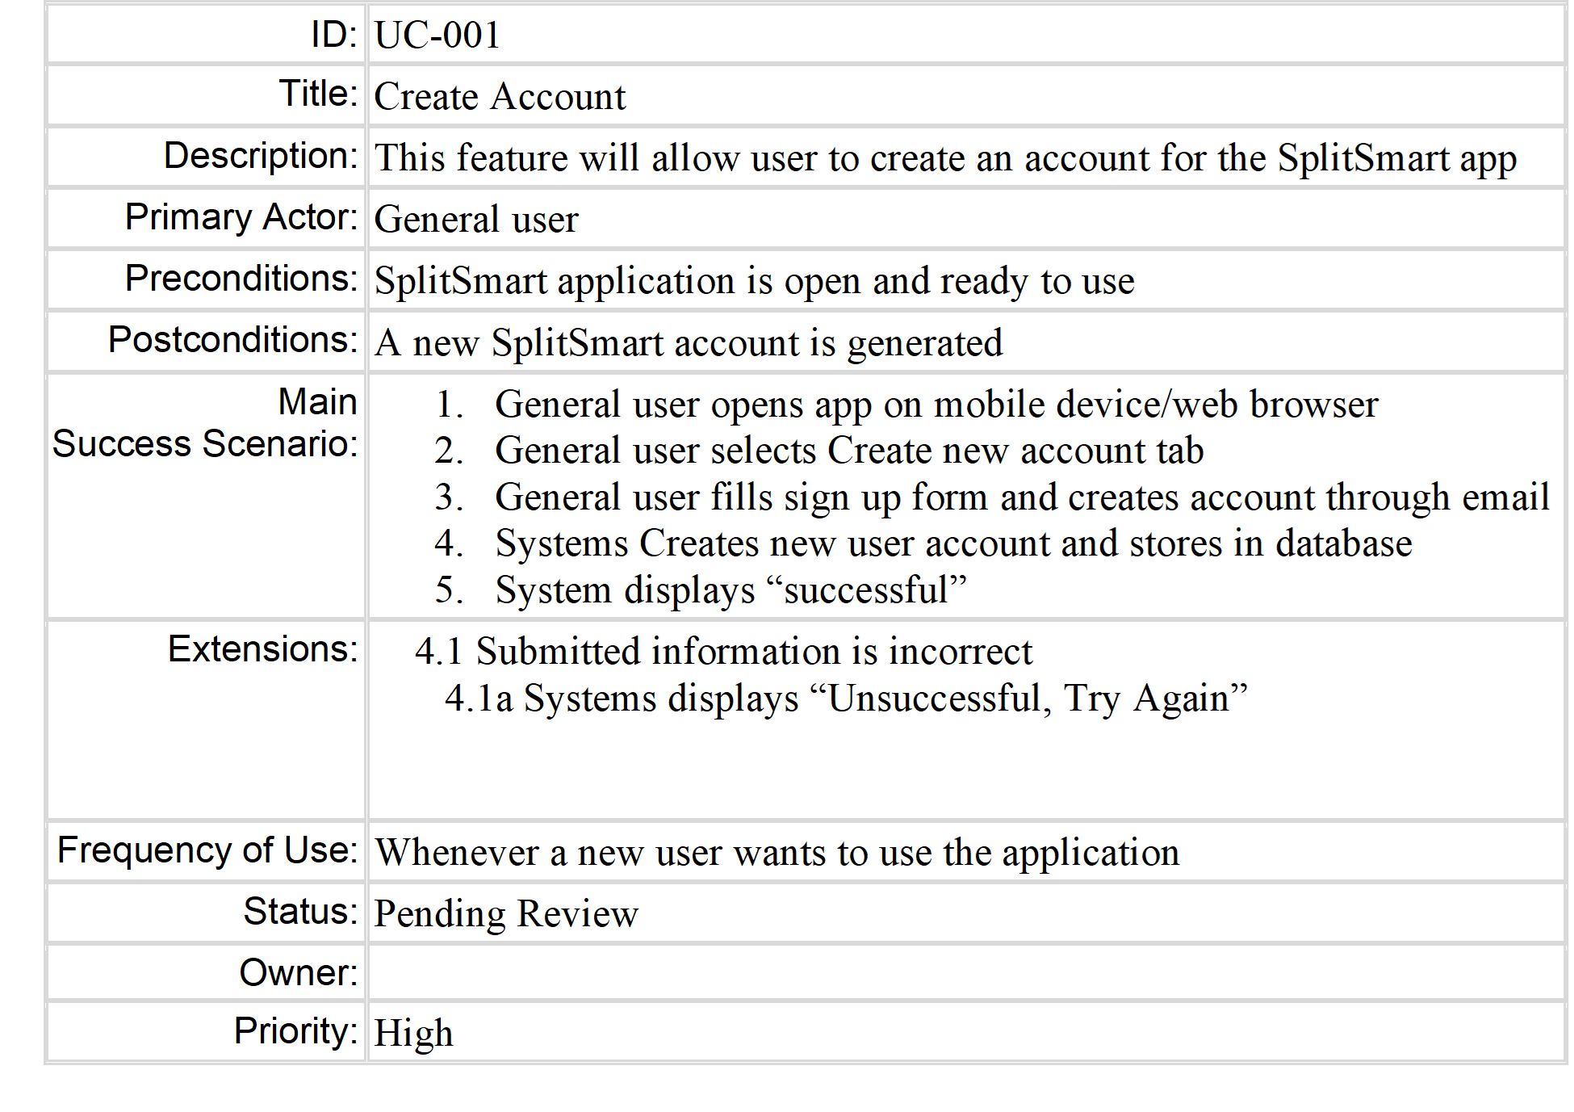
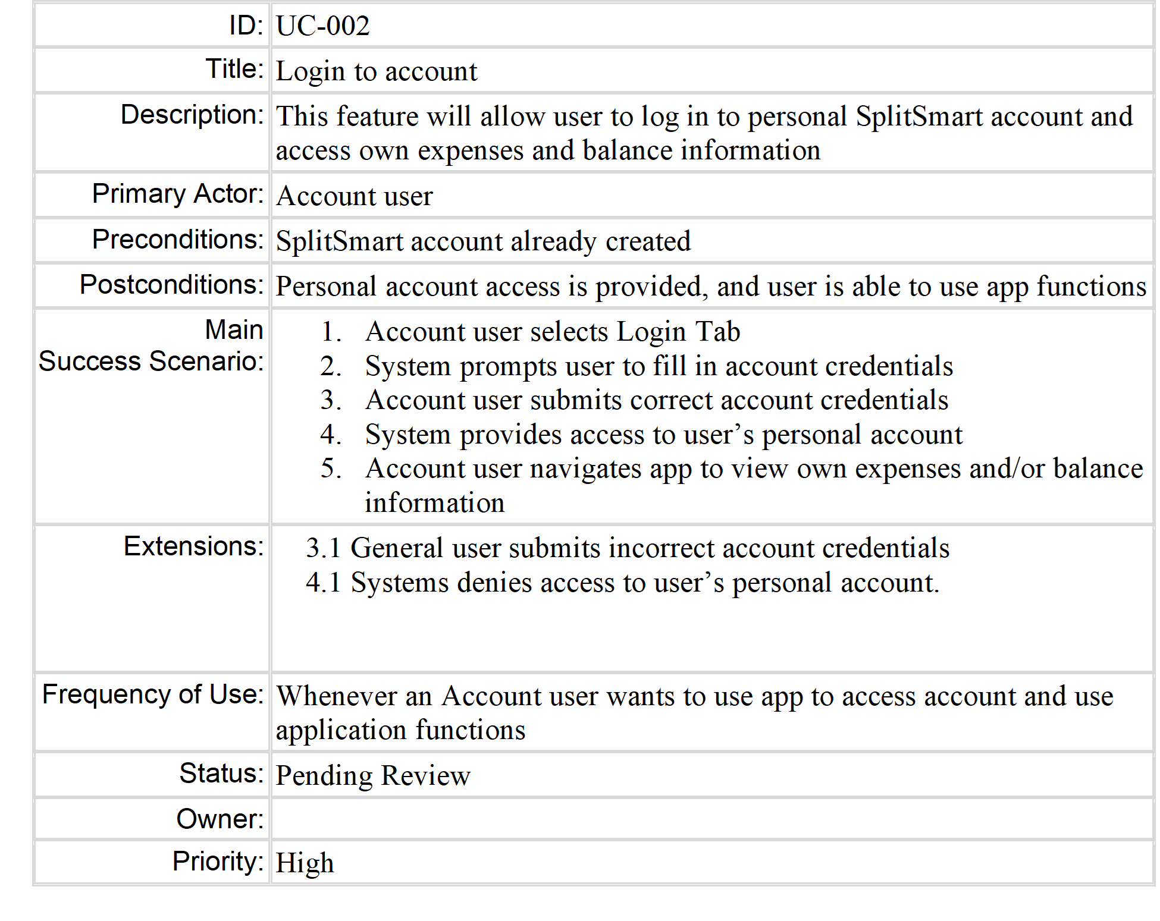
Use Case Cards

Slide 19
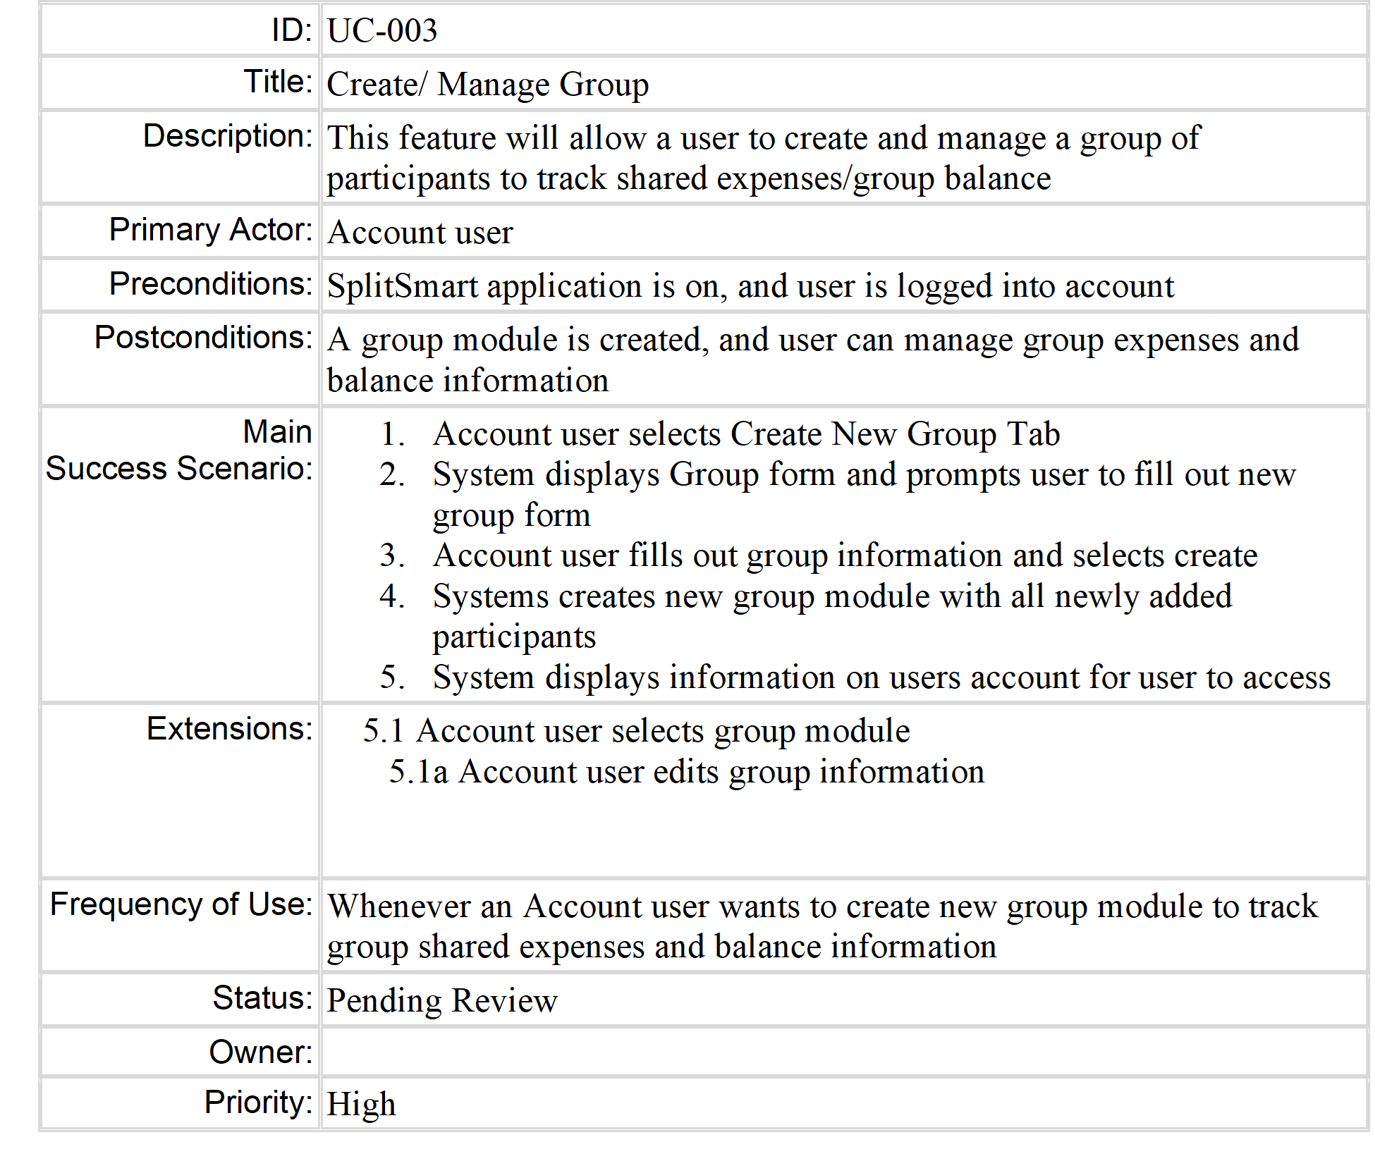
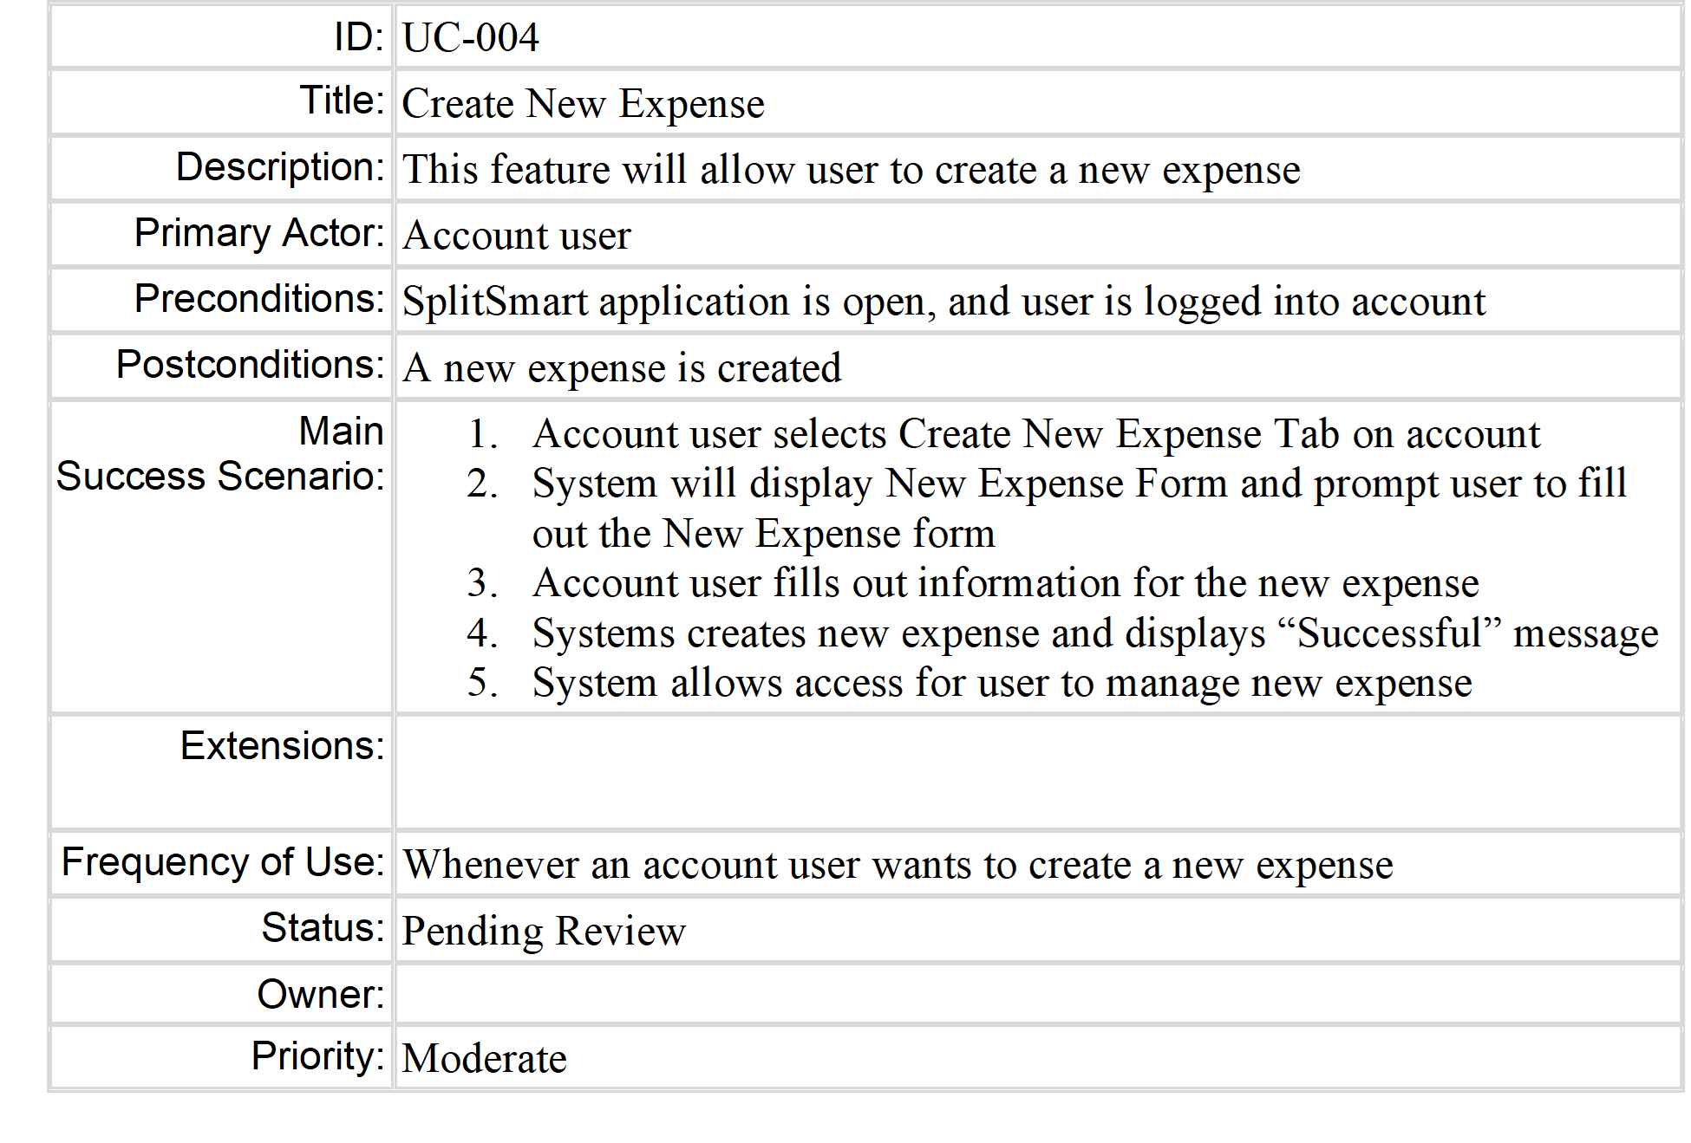

Slide 20
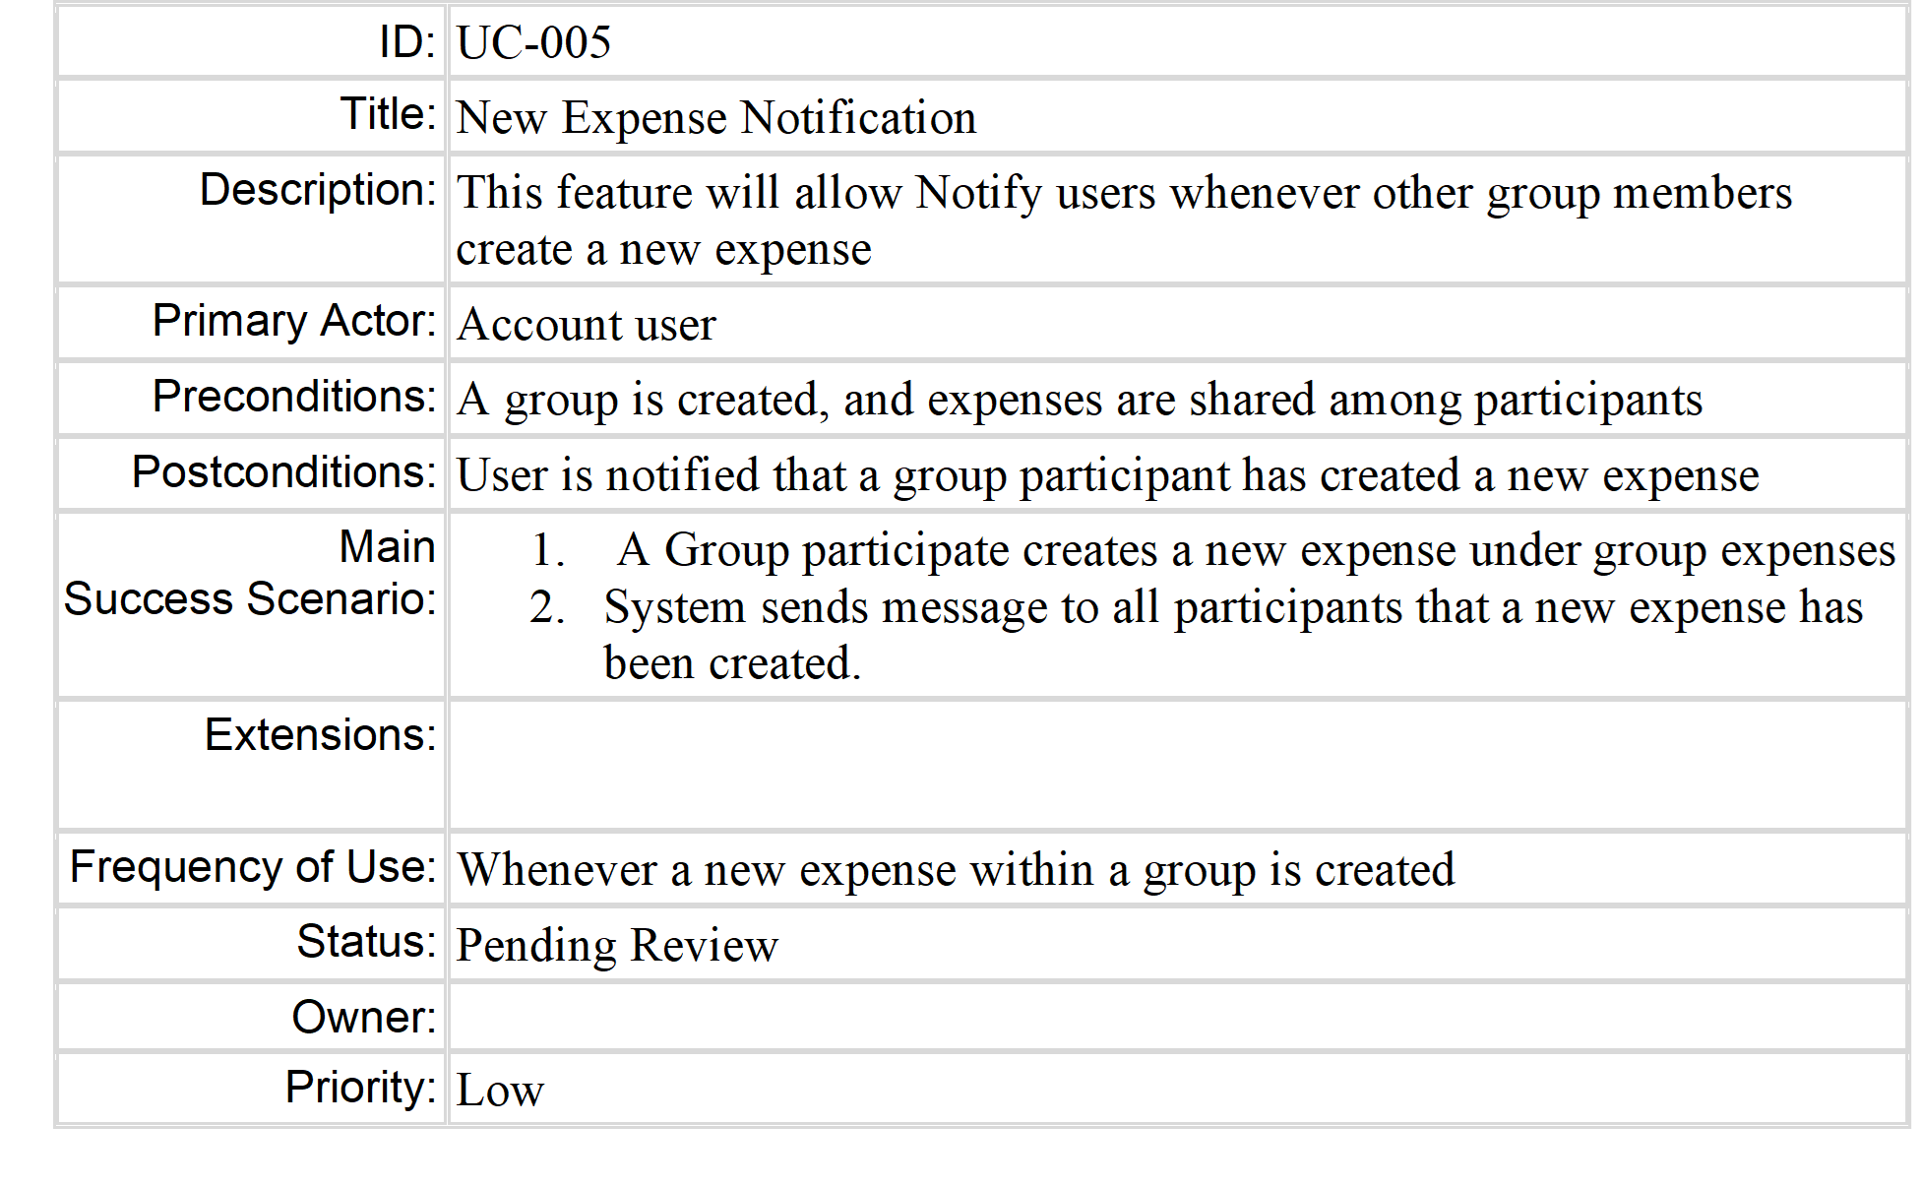
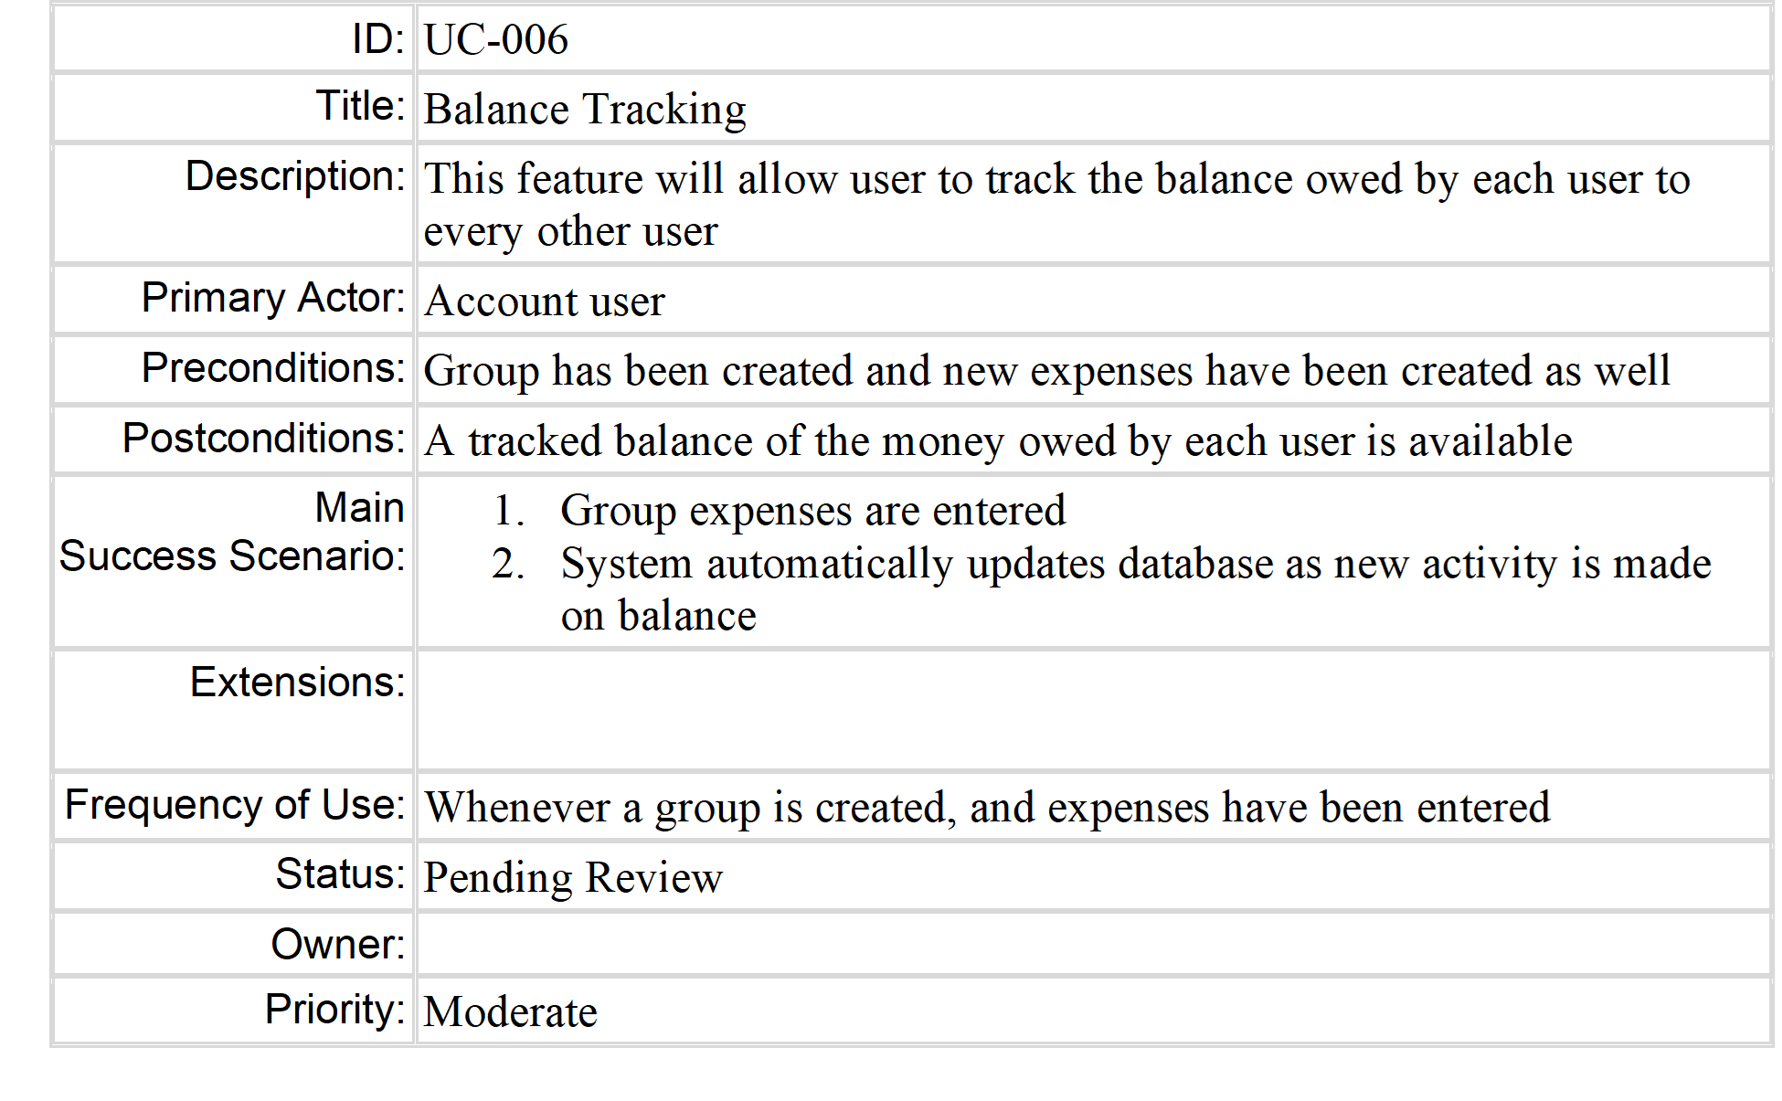

Slide 21
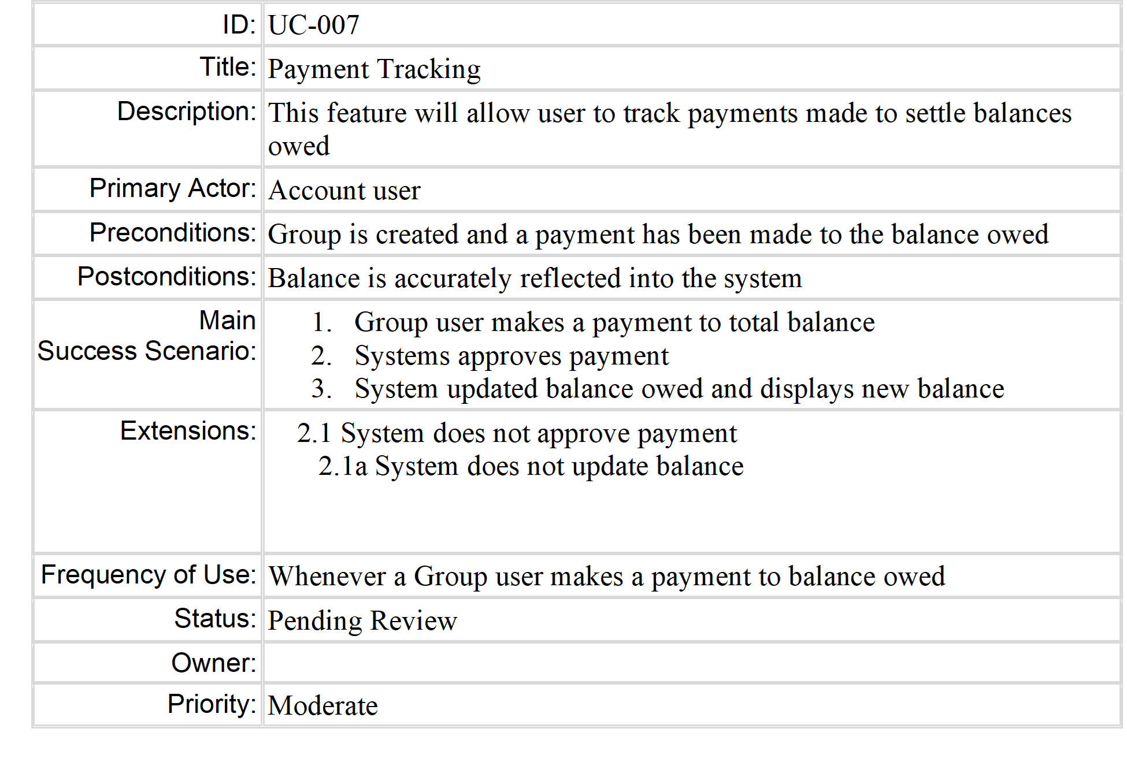
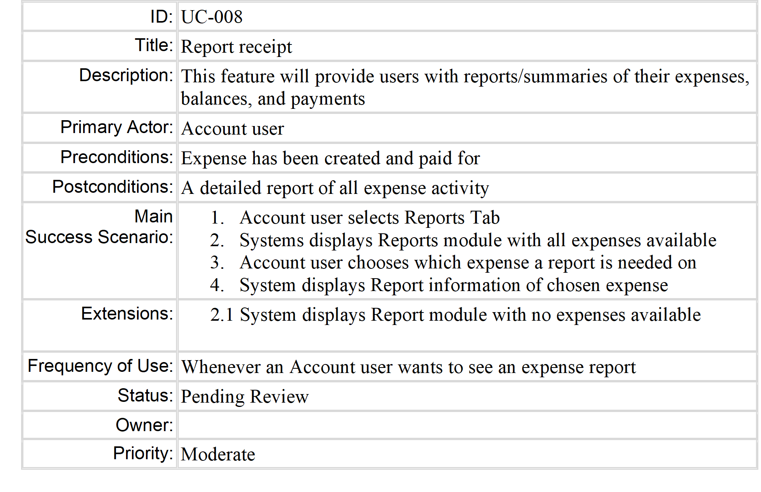

Slide 22
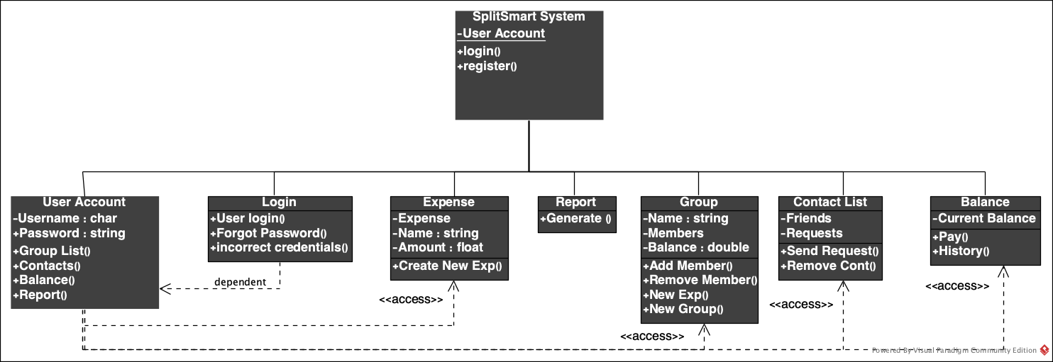
The Class Model

Slide 23

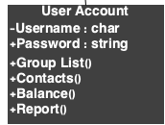
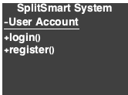

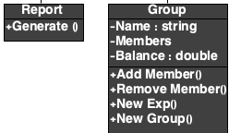


The Classes

